Slide 1
Intro to Bot Framework build your own bot in a minutes…
Azure IoT Tech MeetUp
M Ibnu Fadhil
Gravicode
@gravicode | http://gravicode.com

Slide 2
About Me
Muhammad Ibnu Fadhil
Coder.Entrepreneur
T: @mifmasterz / @gravicode
Founder of
PT Gravicode Multinovative Plexindo
Initiator of Gadgeteer Indonesia
https://www.facebook.com/netgadgeteerindonesia
Contributor in Makers.ID
http://makers.id

Slide 3
BOT FRAMEWORK Build and connect intelligent bots that interact naturally wherever your users are talking, from text/sms to Skype, Slack, Office 365 mail and other popular services

Slide 4
How do you make a bot?
How do you make a bot great?

Slide 5
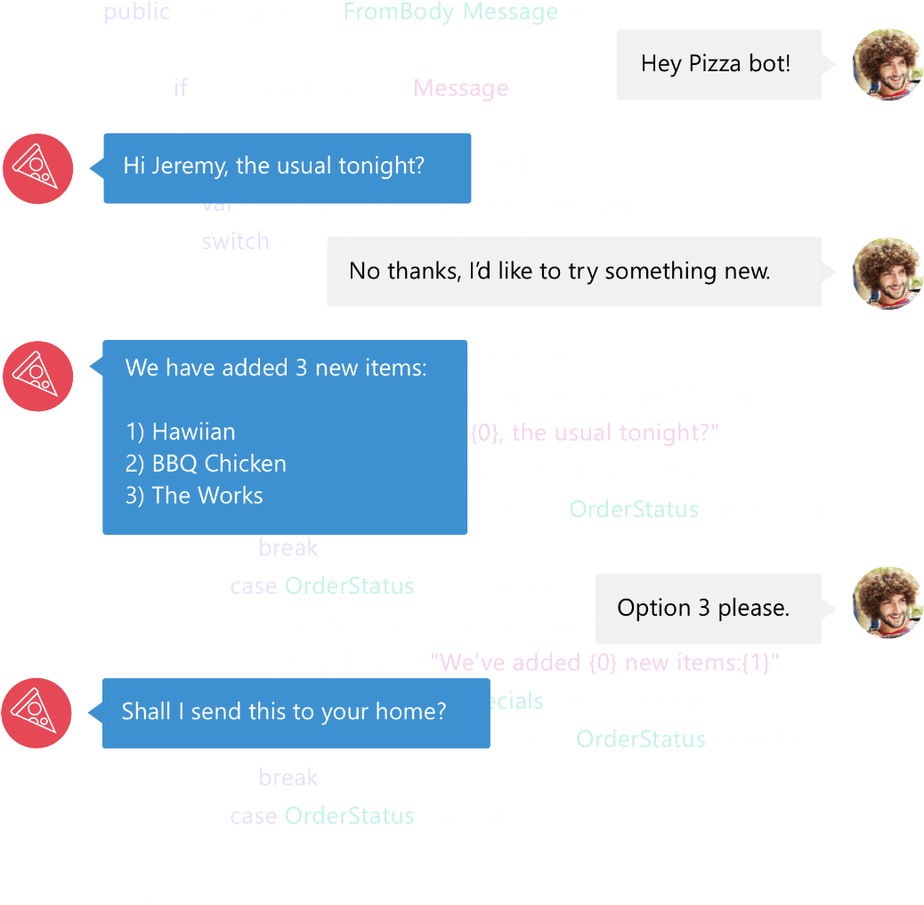

Bot Framework
Bot Framework is a Microsoft-operated service and an SDK.
Bot Framework is one of many tools Microsoft offers for building a complete bot.
Others include: LUIS, Speech APIs, Azure, more
www.botframework.com

Slide 6
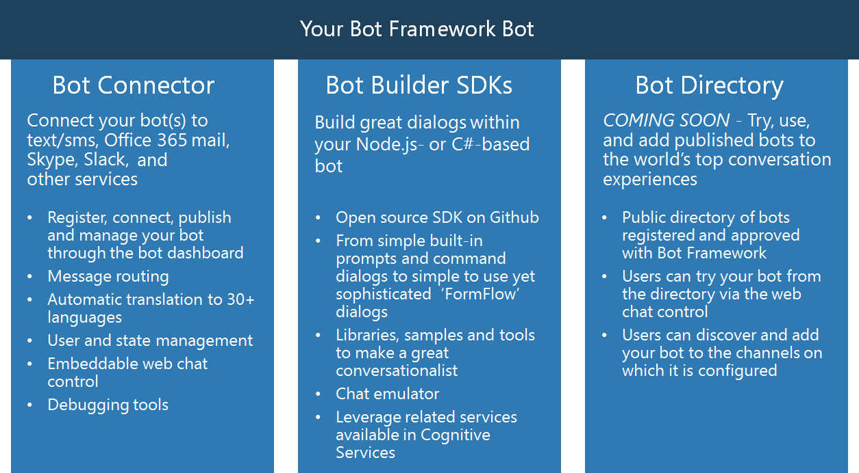

Slide 7
Your bot
Logic
Your conversation logic
Bot Builder SDK (Node.js + C#)
Web service
LUIS

Slide 8
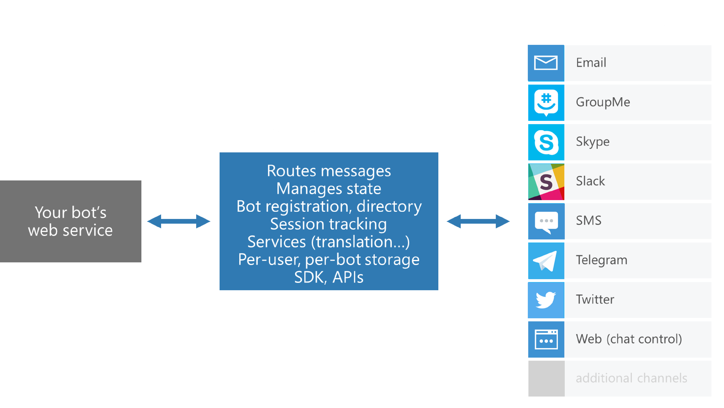
Bot Connector
Dev portal
Bot Connector
Send/receive messages
Store state
Translation
Telemetry
…
Your bot

Slide 9
Bot Connector messages
Your bot
Bot Connector
{
"type": "Message",
"id": "68YrxgtB53Y",
"conversationId": "DphPaFQrDuZDKyCez4AFGcT4vy5aQDje1lLGIjB8v18MFtb",
"language": "en",
"text": "You can say \"/order\" to order!",
"attachments": [ ],
"from": {
"name": "+12065551212",
"channelId": "sms",
"address": "+12065551212",
"id": "Ro52hKN287",
"isBot": false
},
"channelData": { SMS data here },
"botUserData": { your data here },
...
}

Slide 10
Visual Studio Template
Simple Assistant Bot
LUIS
Publish to Azure
Add dialog smarts
Connect to users

Slide 11
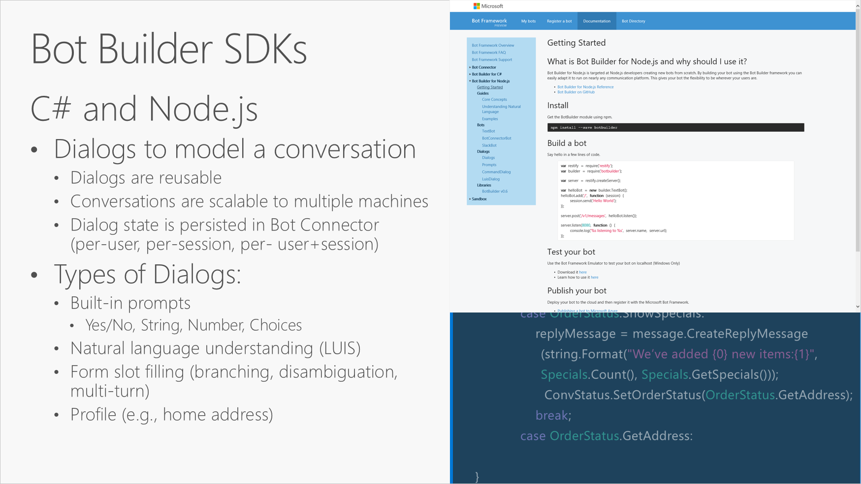

Slide 12
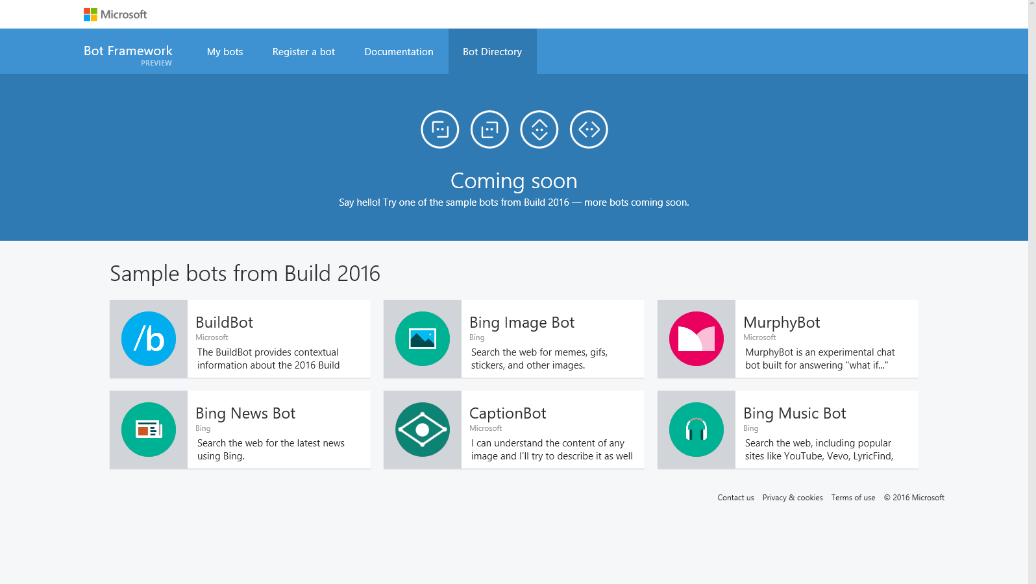

Slide 13
File -> New bot
Visual Studio Template
Simple Assistant Bot
LUIS
Publish to Azure
Add dialog smarts
Connect to users

Slide 14
Connecting your bot to users
Visual Studio Template
Simple Assistant Bot
LUIS
Publish to Azure
Add dialog smarts
Connect to users

Slide 15
Dialog smarts
Visual Studio Template
Simple Assistant Bot
LUIS
Publish to Azure
Add dialog smarts
Connect to users

Slide 16
Resources
botframework.com
Bot Builder Samples :
https://github.com/Microsoft/BotBuilder-Samples
Bot Emulator:
https://github.com/Microsoft/BotFramework-Emulator
Bot Intelligence:
https://docs.botframework.com/en-us/bot-intelligence/getting-started/
C# SDK:
https://docs.botframework.com/en-us/csharp/builder/sdkreference/
Node.js SDK:
https://docs.botframework.com/en-us/node/builder/overview/
Publish Bot to Azure:
https://docs.botframework.com/en-us/csharp/builder/sdkreference/gettingstarted.html
www.botframework.com

Slide 17
Demo Time !!
Notes:
Get attendees hands on quickly to make it ‘real’
We’ve prepared lab content for attendees to use, so they can start working with the Azure IoT services (in a hands-on fashion) throughout the day.

Slide 18
Demo 1:
Basic Bot
Notes:
Get attendees hands on quickly to make it ‘real’
We’ve prepared lab content for attendees to use, so they can start working with the Azure IoT services (in a hands-on fashion) throughout the day.

Slide 19
Demo 2:
Create Bot using LUIS
Notes:
Get attendees hands on quickly to make it ‘real’
We’ve prepared lab content for attendees to use, so they can start working with the Azure IoT services (in a hands-on fashion) throughout the day.

Slide 20
Demo 3:
Create your online shop ‘assistant’ bot
Notes:
Get attendees hands on quickly to make it ‘real’
We’ve prepared lab content for attendees to use, so they can start working with the Azure IoT services (in a hands-on fashion) throughout the day.

Slide 21
Demo 4:
Put some intelligence in your bot
Notes:
Get attendees hands on quickly to make it ‘real’
We’ve prepared lab content for attendees to use, so they can start working with the Azure IoT services (in a hands-on fashion) throughout the day.

Slide 22
Demo 5:
Publishing your bot to azure and make it available on chat channels
Notes:
Get attendees hands on quickly to make it ‘real’
We’ve prepared lab content for attendees to use, so they can start working with the Azure IoT services (in a hands-on fashion) throughout the day.

Slide 23
Thank You!
“Empower your business with intelligence app”
fadhil@Gravicode.com

